Slide 1
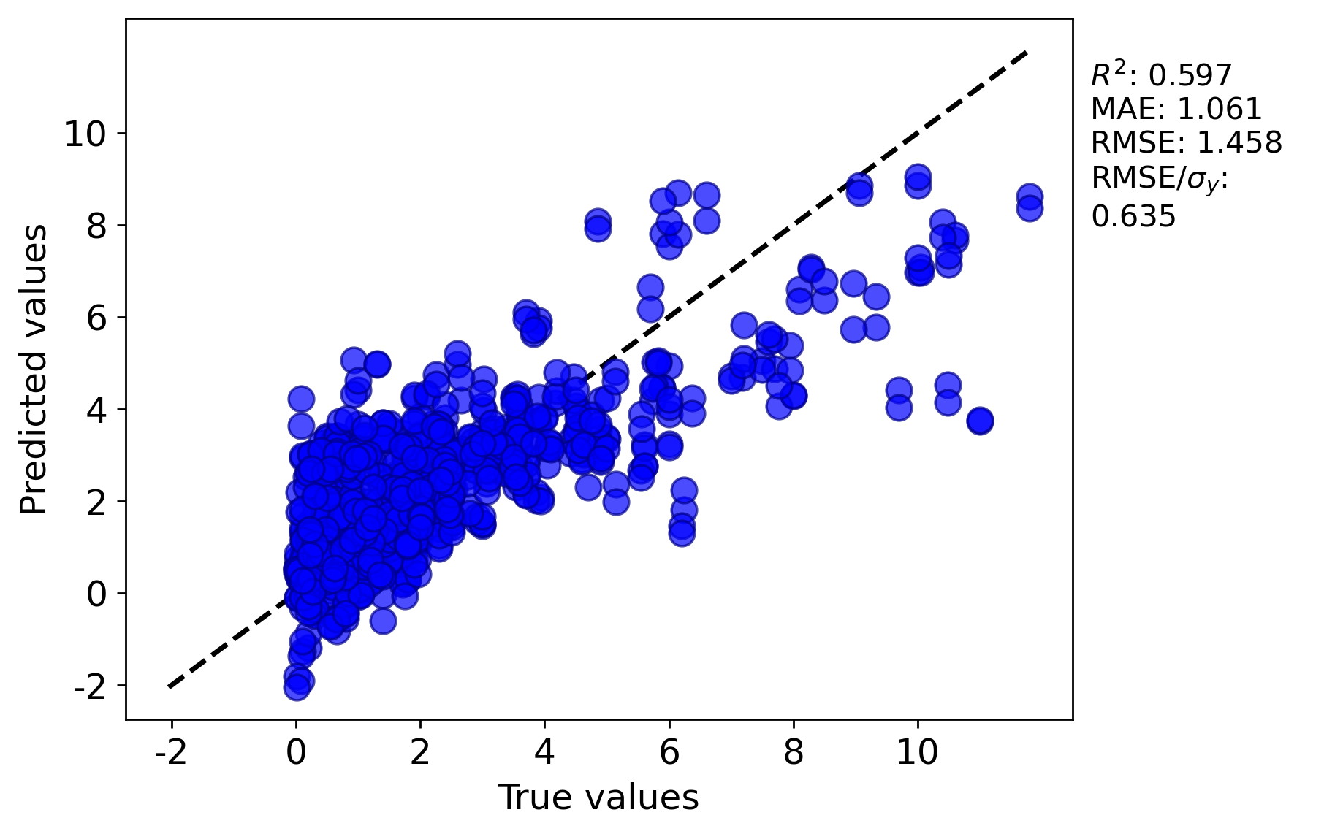
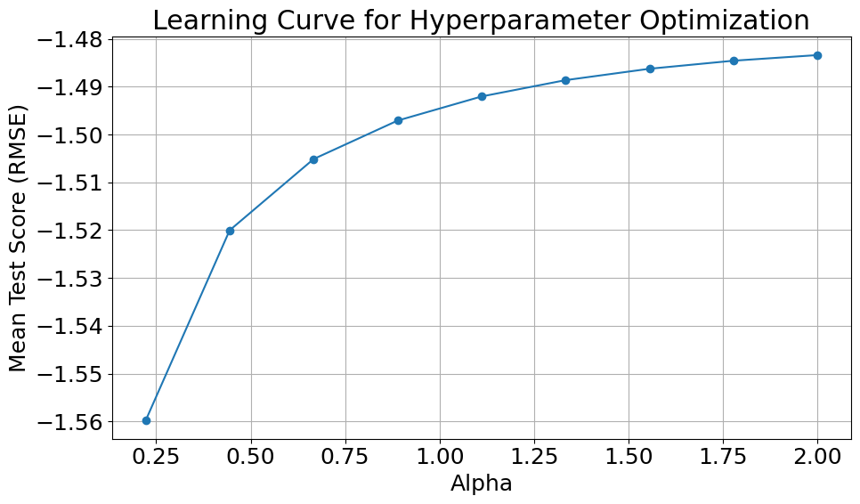

Assessment Figures

Slide 2
ML4ER Assignment 5
Jiahui Yang
Informatics Skunkworks
MSE 401, 3 Credits
Aug 01 2024

Slide 3
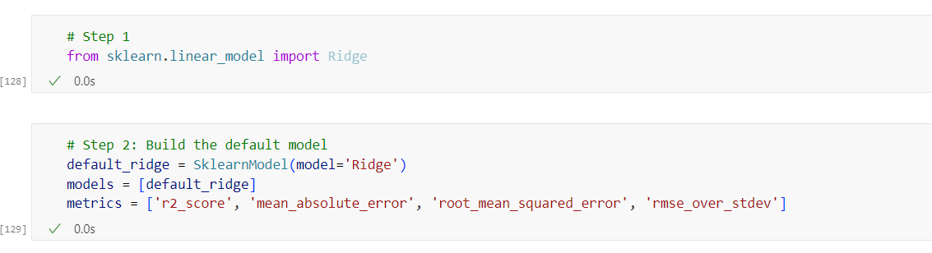
Progress
Section 5 Step 1 and Step 2
Import the Ridge model from sklearn.linear_model and create a default Ridge model using SklearnModel, specifying the evaluation metrics.

Slide 4
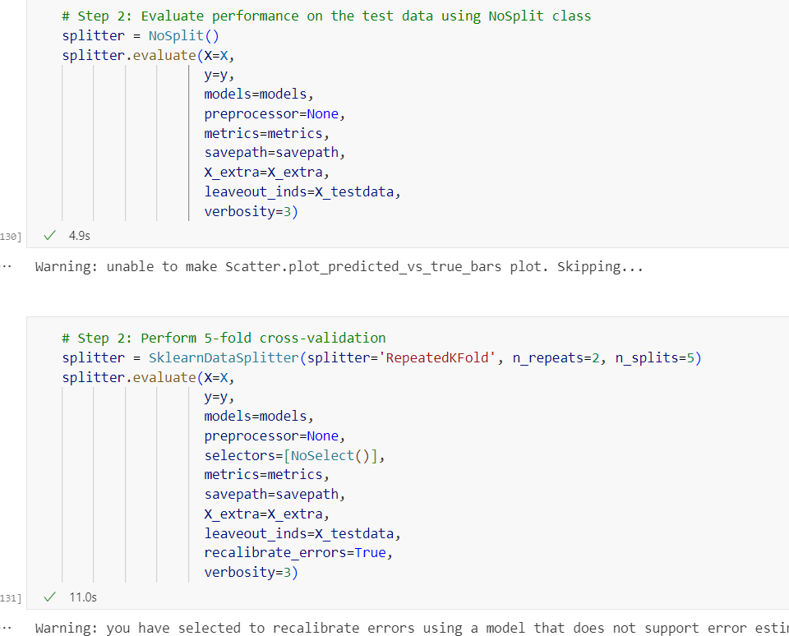
Progress
Evaluate performance on the test data using the NoSplit class, then perform 5-fold cross-validation using RepeatedKFold with 2 repeats.
Section 5 Step 2

Slide 5
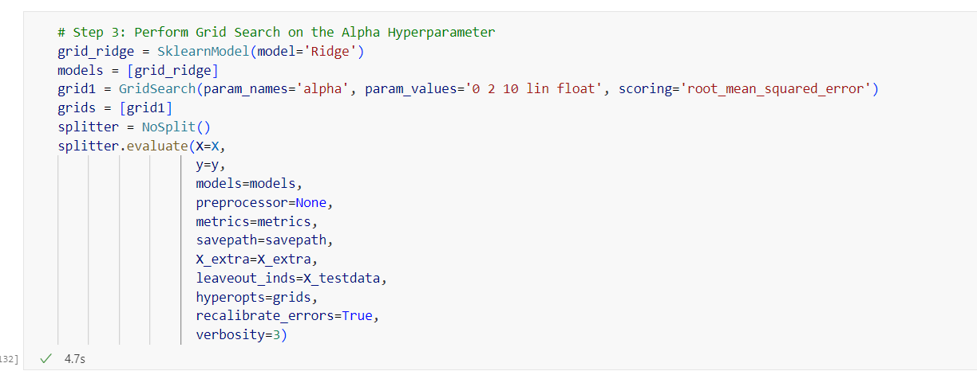
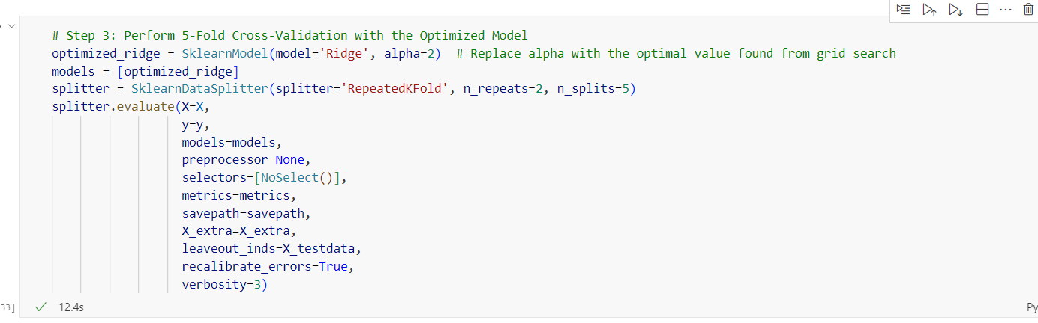
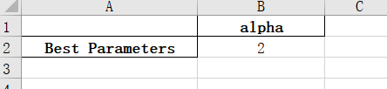
Progress
Perform a grid search on the alpha hyperparameter using NoSplit, then conduct 5-fold cross-validation with the optimized model using RepeatedKFold (2 repeats, 5 splits).
Section 5 Step 3

Slide 6
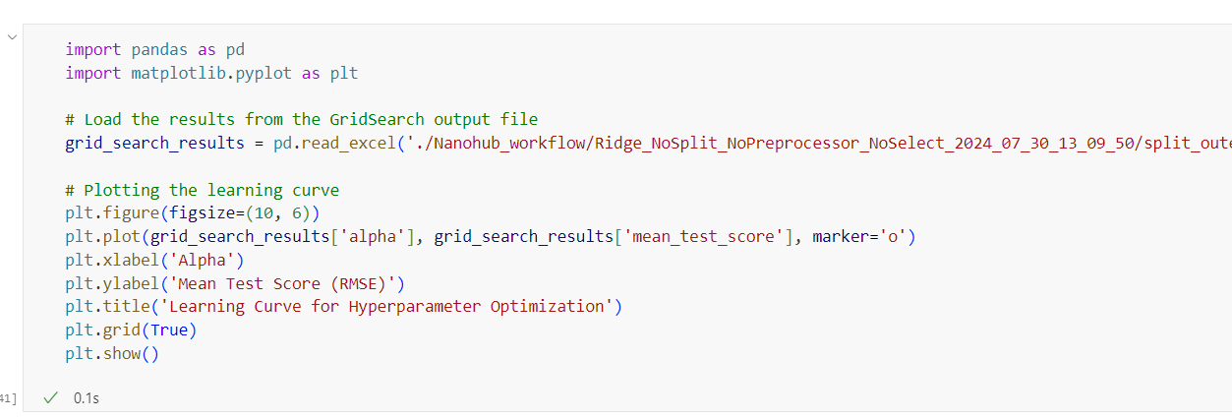
Progress
Python code that reads GridSearch results from an Excel file and plots a learning curve of alpha values against mean_test_score (RMSE).
Section 5 Step 3 Plot

Slide 7
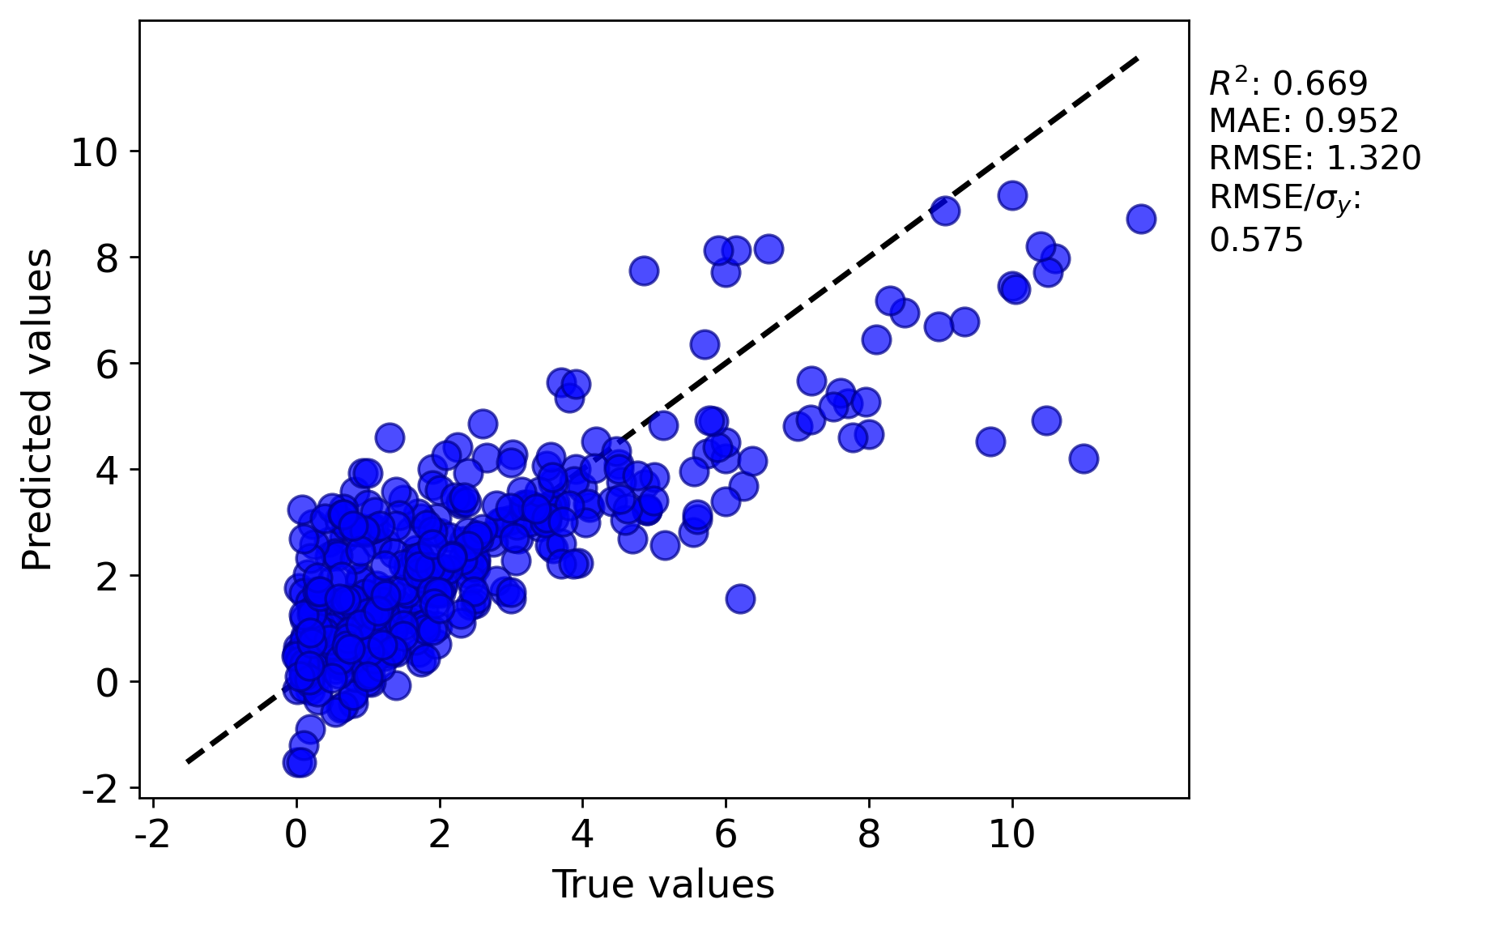
Progress
Test data parity plot of your default chosen model from Section 5 (NoSplit)
This scatter plot shows predicted values versus true values, with an R² of 0.669, MAE of 0.952, RMSE of 1.320, and RMSE/σᵧ of 0.575.

Slide 8
Progress
Test data parity plot of your default chosen model from Section 5 (5-fold cross-validation)
This scatter plot shows predicted values versus true values, with an R² of 0.597, MAE of 1.061, RMSE of 1.458, and RMSE/σᵧ of 0.635.

Slide 9
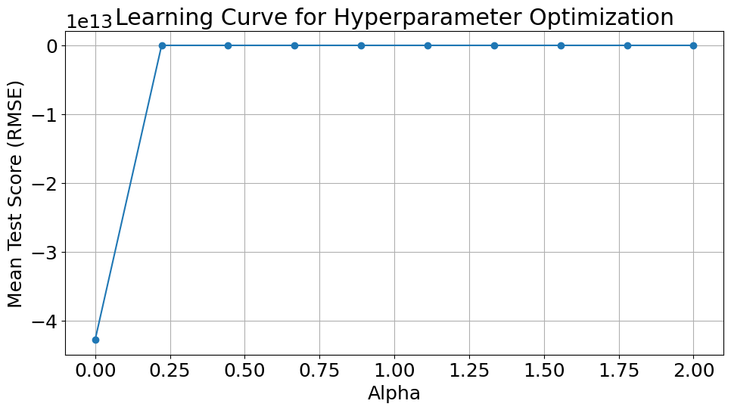
Progress
Learning curve for your hyperparameter optimization from Section 5 (NoSplit)
/split_outer_0/Split_0/*_Output.xlsx
As alpha increases from 0.25 to 2.0, the RMSE value decreases, indicating improved model performance. The curve highlights how different alpha values affect the model's prediction accuracy.

Slide 10
Progress
Test data parity plot of your optimized model performance from Section 5 (5-fold cross-validation)
This scatter plot shows predicted values versus true values, with an R² of 0.592, MAE of 1.059, RMSE of 1.467, and RMSE/σᵧ of 0.639.

Slide 11
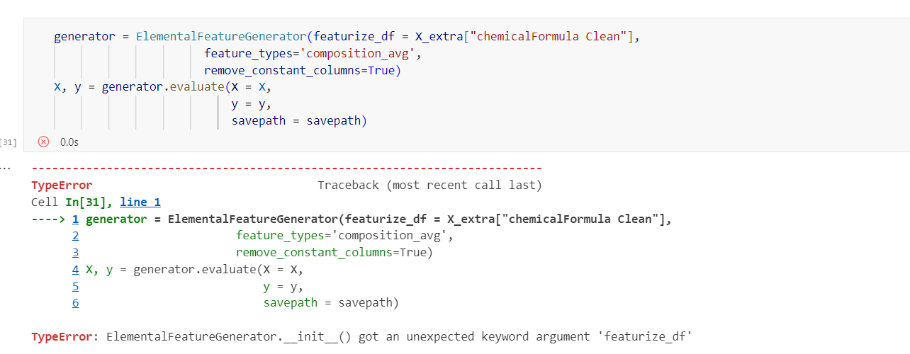
Problems
I had an issue caused by the version of the MAST-ML installation. Changing featurize_df to composition_df resolved the problem.

Slide 12
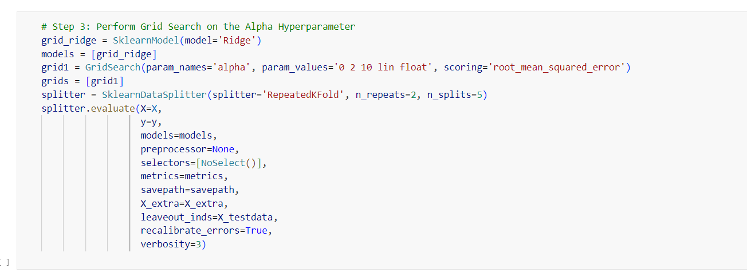
Questions
Can I use GridSearch along with cross-validation simultaneously?

Slide 13
Hours Summary
Date | Hours | Description of Work
07/30/2024 | 5 hours | Complete module 4: Comparing Model types

